Slide 1
Introduction to Project Management
Chapter 1
Information Technology Project Management, Seventh Edition

Slide 2
Introduction
The world as a whole spends nearly $10 trillion of its $40.7 trillion gross product on projects of all kinds
More than 16 million people regard project management as their profession
The overall information and communications technology market grew by 6 percent to almost $3 trillion in 2010

Slide 3
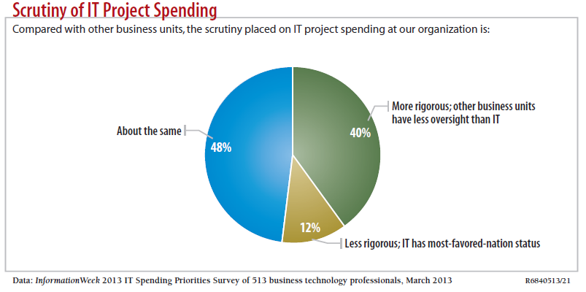
Motivation for Studying Information Technology (IT) Project Management
IT Projects have a terrible track record, as described in the “What Went Wrong?”

Slide 4
Advantages of Using Formal Project Management
Better control of financial, physical, and human resources
Improved customer relations
Shorter development times
Lower costs
Higher quality and increased reliability
Higher profit margins
Improved productivity
Better internal coordination
Higher worker morale

Slide 5
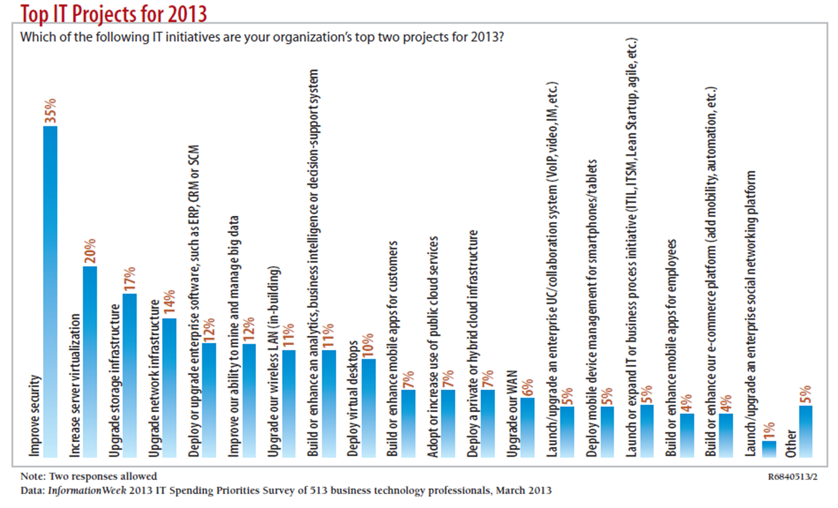
What Is a Project?
A project is “a temporary endeavor undertaken to create a unique product, service, or result” (PMBOK® Guide, Fifth Edition, 2012)

Slide 6
Project Attributes
A project
has a unique purpose
is temporary
is developed using progressive elaboration
requires resources, often from various areas
should have a primary customer or sponsor
The project sponsor usually provides the direction and funding for the project
involves uncertainty

Slide 7
Project and Program Managers
Project managers work with project sponsors, project team, and other people involved in a project to meet project goals
Program: group of related projects managed in a coordinated way to obtain benefits and control not available from managing them individually (PMBOK® Guide, Fifth Edition, 2012)

Slide 8
Program and Project Portfolio Management
A program is “a group of related projects managed in a coordinated way to obtain benefits and control not available from managing them individually” (PMBOK® Guide, Fifth Edition, 2012)
A program manager provides leadership and direction for the project managers heading the projects within the program

Slide 9
PM Network: What’s in a Name?
Programs vs. Projects
Should there be a difference?
What are the problems with labeling a program as a large project?
Are different skills needed to be a program manager compared to a project manager?

Slide 10
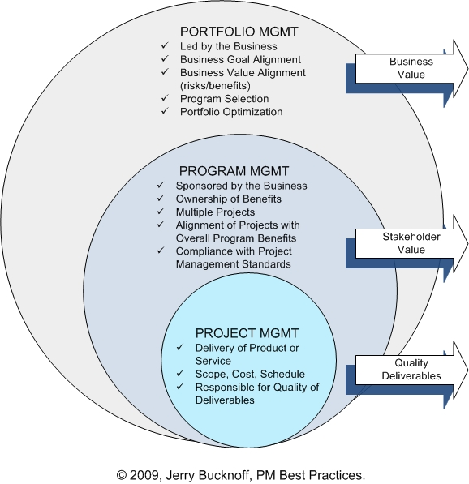
Project Portfolio Management
Organizations group and manage projects and programs as a portfolio of investments that contribute to the entire enterprise’s success

Slide 11
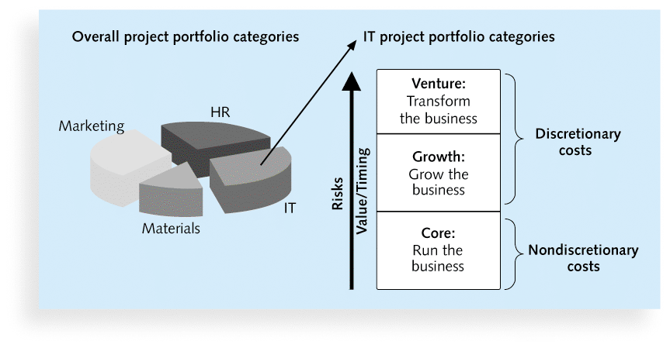
Sample Project Portfolio Approach

Slide 12
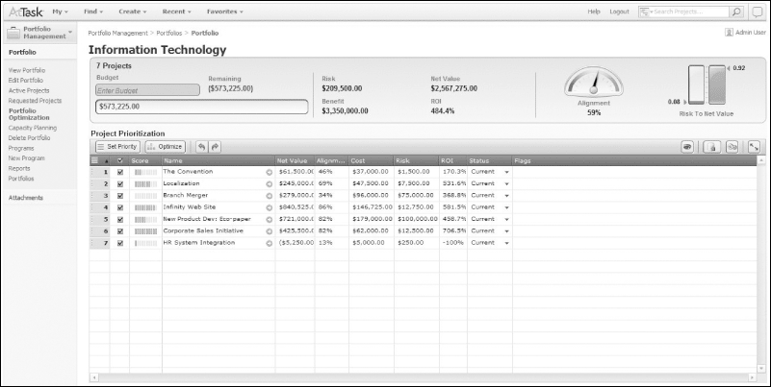
Figure 1-5. Sample Project Portfolio Management Screen Showing Portfolio Optimization

Slide 13
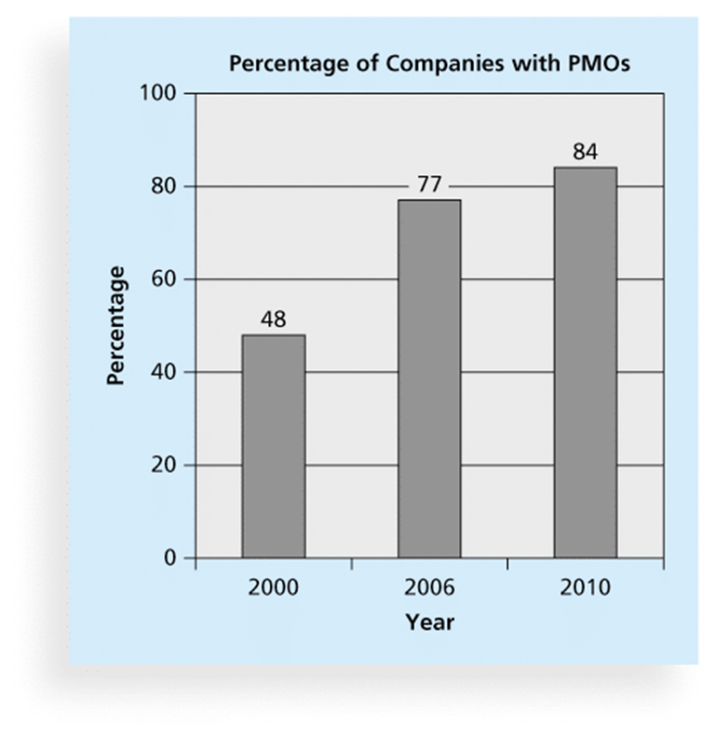
Project Management Offices
A Project Management Office (PMO) is an organizational group responsible for coordinating the project management function throughout an organization

Slide 14
PM Network - PMO 2.0
Why do PMOs fail?
What is the primary reason cited for failure?
How do you resurrect a failed PMO?
How do you ensure longevity of a PMO?
When should a PMO just be closed?

Slide 15
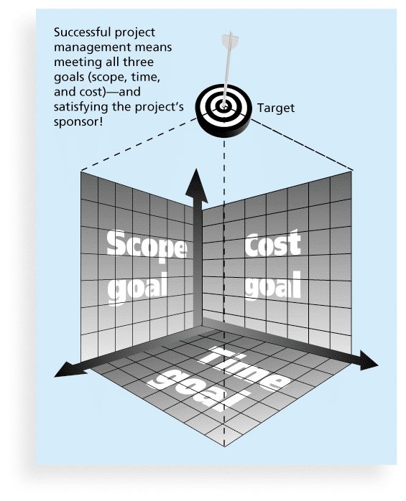
The Triple Constraint of Project Management

Slide 16
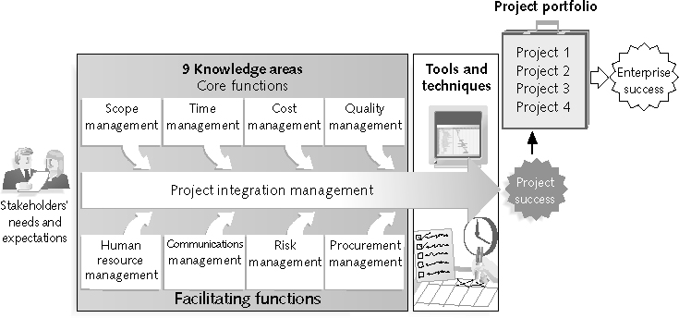
What is Project Management?
“the application of knowledge, skills, tools and techniques to project activities to meet project requirements” (PMBOK® Guide, Fourth Edition, 2012)
Stakeholders
Core Functions
Facilitating
Functions

Slide 17
Project Management Knowledge Areas
Knowledge areas describe the key competencies that project managers must develop
Core Functions
Facilitating Functions
Integration Function

Slide 18
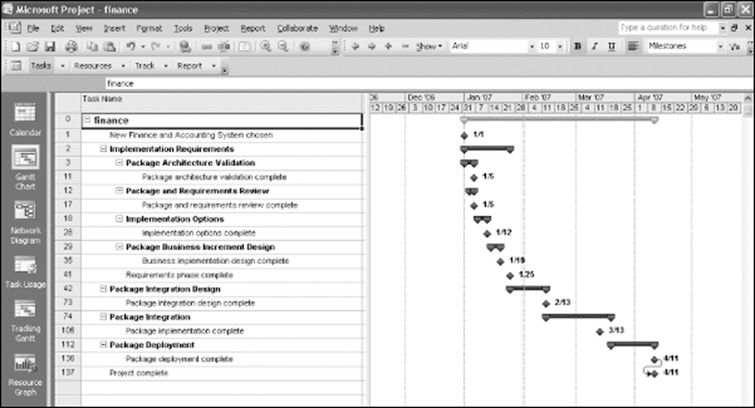
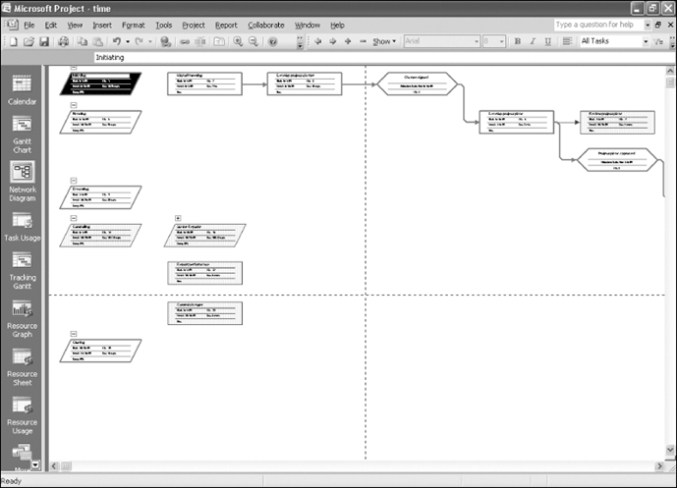
Project Management Tools and Techniques
Project management tools and techniques assist project managers and their teams in various aspects of project management
network diagram
Gantt chart

Slide 19
Project Stakeholders
Stakeholders are the people involved in or affected by project activities
Who are the stakeholders in a project?

Slide 20
Why the Improvements?
What Went Right? Improved Project Performance

Slide 21
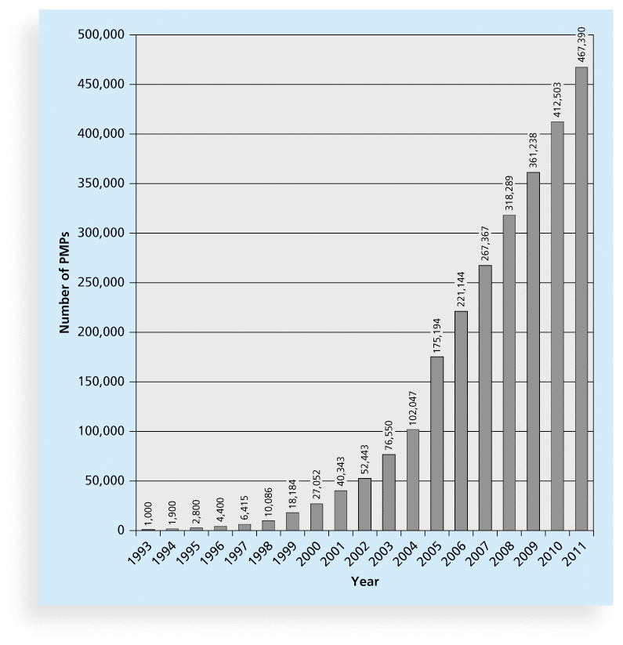
Coincidence?
Improved Project Performance
Growth in PMP Certification, 1993-2011

Slide 22
Project Success
There are several ways to define project success:
Triple Constraint
Customer/Sponsor Satisfaction
The results of the project met its main objective

Slide 23
What Helps Projects Succeed?*
1. User involvement
2. Executive support
3. Clear business objectives
4. Emotional maturity
5. Optimizing scope
6. Agile process
7. Project management expertise
8. Skilled resources
9. Execution
10. Tools and infrastructure
*The Standish Group, “CHAOS Activity News” (August 2011).

Slide 24
The Role of the Project Manager
Job descriptions vary, but most include responsibilities like planning, scheduling, coordinating, and working with people to achieve project goals
Remember that 97% of successful projects were led by experienced project managers, who can often help influence success factors

Slide 25
Suggested Skills for Project Managers
The Project Management Body of Knowledge
Application area knowledge, standards, and regulations
Project environment knowledge
General management knowledge and skills
Soft skills or human relations skills

Slide 26
Ten Most Important Skills and Competencies for Project Managers
1. People skills
2. Leadership
3. Listening
4. Integrity, ethical behavior, consistent
5. Strong at building trust
6. Verbal communication
7. Strong at building teams
8. Conflict resolution, conflict management
9. Critical thinking, problem solving
10. Understands, balances priorities

Slide 27
Importance of Leadership Skills
Effective project managers provide leadership by example
A leader focuses on long-term goals and big-picture objectives while inspiring people to reach those goals
A manager deals with the day-to-day details of meeting specific goals
Project managers often take on the role of both leader and manager

Slide 28
Different Skills Needed in Different Situations
Large projects
High uncertainty projects
Very novel projects

Slide 29
Careers for IT Project Managers
In a 2012 survey, IT executives listed the “nine hottest skills” they planned to hire for in 2013
Project management was second only to programming and application development
Job Categories | Total Current Employees Rank | Growth Rank
Big Data / Analyst | 6 | 1
Business/Systems Analyst | 3 | 3 (tie)
Database Admin / Analyst | 7 | 3 (tie)
Networks / Security | 5 | 5
Project Management | 4 | 2
Software Development | 2 | 6
Other IT Skills( Primarily Help Desk) | 1 | 7

Slide 30
Nine Hottest Skills*
Skill |  | Percentage of Respondents
Programming and application development |  |  | 60%
Project management |  |  | 44%
Help desk/technical support |  |  | 35%
Networking |  |  | 35%
Business intelligence |  |  | 23%
Data center |  |  | 18%
Web 2.0 |  |  | 18%
Security |  |  | 17%
Telecommunications |  |  | 9%
*Source: Rick Saia, “9 Hot IT Skills for 2012,” Computerworld, September 26, 2011.

Slide 31
The Project Management Profession
The profession of project management is growing at a very rapid pace
It is helpful to understand the history of the field, the role of professional societies like the Project Management Institute, and the growth in project management software

Slide 32
Global Issues
Several global dynamics are forcing organizations to rethink their practices:
Talent development for project and program managers is a top concern
Good project portfolio management is crucial in tight economic conditions
Basic project management techniques are core competencies
Organizations want to use more agile approaches to project management
Benefits realization of projects is a key metric

Slide 33
Project Management Certification
The Project Management Institute (PMI) is an international professional society for project managers with 380,000 members worldwide in 2012
Project Management Professional (PMP) has documented sufficient project experience, agreed to follow a code of ethics, and passed the PMP exam
Certified Associate in PM (CAPM) is achievable with less experience
CompTIA offers another certification option
CompTIA Project+ has less requirements but is not as well recognized as PMP

Slide 34
Ethics in Project Management
Ethics, loosely defined, is a set of principles that guide our decision making based on personal values of what is “right” and “wrong”
Project managers often face ethical dilemmas
In order to earn PMP certification, applicants must agree to PMI’s Code of Ethics and Professional Conduct
Several questions on the PMP exam are related to professional responsibility, including ethics

Slide 35
Project Management Software
There are hundreds of different products to assist in performing project management
Three main categories of tools:
Low-end tools
Midrange tools
High-end tools

Slide 36
Project Management Software
Various software includes:
BaseCamp
Clarizen
Collabtive (open source)
dotProject (open source)
OneDesk
Genius Inside
PlanBox

Slide 37
Class Summary
Project Definition
Difference between project, program and portfolio
Project Management Office
Certification Opportunities
PMI/PMP
CompTIA

